Slide 1

The use of Cochrane breast cancer reviews by guideline developers and Cochrane (public) users
ML Willson, D O’Connell, A Goodwin, N Wilcken
Cochrane Breast Cancer Group, NHMRC Clinical Trials Centre

Slide 2

Setting the scene
A scoping exercise
Increasing volume of trial data available (Bastian et al, PLoS Medicine 2010)
Utility of systematic reviews:
can guide treatment decisions
part of the research evidence component of clinical practice guidelines
Aim:
assess Cochrane review usage by clinical guidelines and our readers
Notes:
This presentation will cover how well Cochrane systematic reviews intersect with clinical practice guidelines, AND the findings are based on a preliminary scoping exercise by our Cochrane Review Group.
As many of you know, there is an increasing volume of trial data on healthcare interventions, and with this information overload, systematic reviews can be powerful tools for those of us trying to make sense of it all. Briefly, systematic reviews can, if done appropriately, provide an estimate of how well a healthcare intervention works, examine differences across individual studies and can guide treatment (and cost-effective treatment) decisions.
They can also be a useful foundation when assimilating research evidence and expert opinion on pressing clinical issues in clinical practice guidelines.
In view of this intersection between reviews and guidelines, we wanted to explore the uptake of our Cochrane systematic reviews in clinical practice guidelines, and compare reviews used in guidelines to those of our general readers.

Slide 3

Cochrane Breast Cancer Group: producers of Cochrane (systematic) Reviews
Established in 1996
Search for evidence, evaluate its quality and publish results as Cochrane Reviews
Published in an online database and available via The Cochrane Library
Reviews known to be methodologically rigorous
Over 88 Protocols, Reviews and Titles
Sometimes integrated into clinical practice guidelines
Notes:
Some background about us:
We were installed in Sydney in 1996, and
Our work involves searching the research evidence, formally appraising it and publishing the results in the form of Cochrane (systematic) reviews in breast cancer. The reviews are published online and full-texts are available via The Cochrane Library.
They are generally known to be methodologically rigorous, and our Group has facilitated the development over 88 Protocols, Reviews and Registered Titles. Some of our reviews are integrated into clinical practice guidelines.

Slide 4
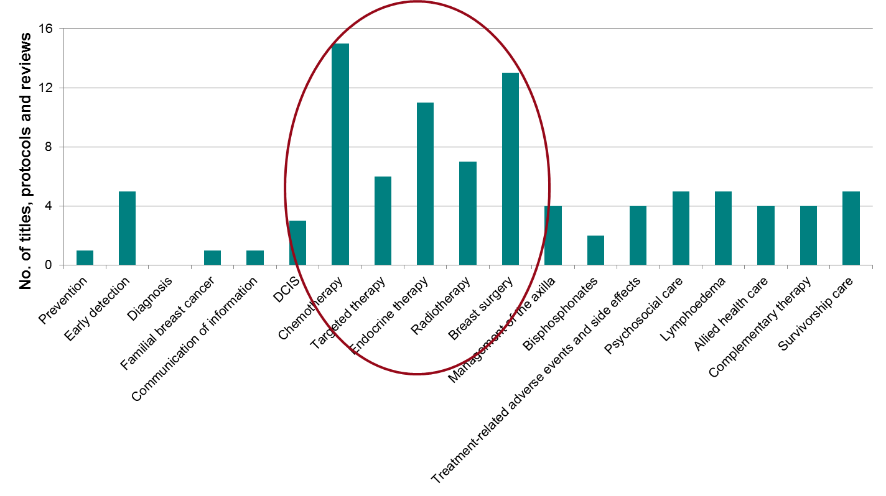
Cochrane Breast Cancer Group: Review portfolio
Topics are decided upon by an international, multidisciplinary Editorial Board
Notes:
Our current review portfolio covers a broad range of topics and the majority relate to treatment.
Similar to clinical practice guidelines, these topics are decided upon by a multi-disciplinary team made up of breast surgeons, consumers, medical oncologists, and statisticians to name a few.

Slide 5
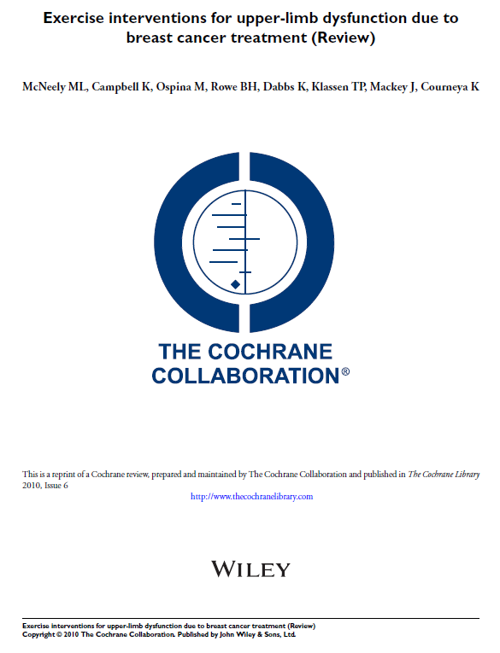
Cochrane Breast Cancer Group: metrics
Publishers provided a short list of 8 ‘most cited’ + top 10 ‘most accessed’
13 of the 18 ‘most cited/accessed’ Review topics covered:
Prevention, early detection, familial breast cancer, allied health (ie exercise), psychosocial care, complementary therapy, lymphoedema
5 of the 18 covered treatments
Chemo- and targeted therapy, radiation and surgery
Notes:
Last year, our Publishers (Wiley) gave us a short list of :
8 ‘most cited’ Cochrane reviews in the medical literature and
top 10 ‘most accessed’ reviews as per full-text reviews from The Cochrane Library.
From these:
13 of the 18 most cited/accessed Reviews covered topics such as prevention and allied health (e.g. exercise interventions for upper-limb dysfunction) while 5 of the 18 were related to treatment for breast cancer
The specific aims of this project were to:

Slide 6
Specific aims
Assess the uptake of Cochrane breast cancer Reviews in clinical practice guidelines
Compare ‘most cited/accessed’ Reviews to those used in guidelines
Notes:
Assess the uptake of Cochrane breast cancer reviews in clinical practice guidelines, and/
Compare our most cited/accessed reviews to those used in guidelines
To do this,

Slide 7
Methods: guideline selection & basic metrics
Selected 7 key clinical guideline developers or consensus panels:
Advanced Breast Cancer Consensus (ABC1)
American Society of Clinical Oncology (ASCO)
Cancer Australia (CA)
Central European Cooperative Oncology Group (CECOG)
European Society for Medical Oncology (ESMO)
National Institute for Health and Care Excellence (NICE)
Scottish Intercollegiate Guideline Network (SIGN)
Published from 2001 to March 2014
For each guideline, recorded:
Number and title of Cochrane Review citations
Scope of guideline
Categorised Cochrane Review usage for each guideline developer
Compared Reviews in guidelines to ‘most cited/accessed’ Reviews
Notes:
We selected, in a non-systematic fashion, 7 key clinical guideline developers or consensus groups in breast cancer as listed here.
Guidelines published from 2001 to March 2014 were included.
In each guideline, we screened the full text and references for Cochrane Review citations, noted the number and title of the Cochrane reviews, and scope of the guideline.
Finally, we categorised Cochrane Review usage for each guideline developer into 4 groups (which I’ll describe later)
AND
Compared reviews used in guidelines to the most cited/accessed reviews

Slide 8
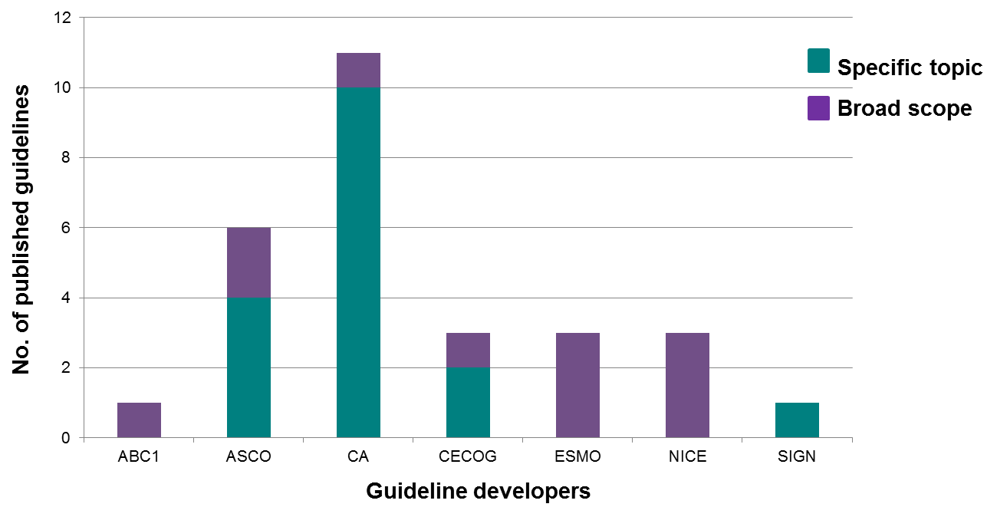
Results: no. and scope of guidelines
28 guidelines included, published July 2001 to July 2013
Notes:
28 breast cancer guidelines from the 7 guideline developers were published during the assessed period. The majority were classified as guidelines while others were classified as consensus statements or consensus guidelines.
ASCO and Cancer Australia contributed substantially to the number of breast cancer guidelines.
Shown in green, around 60% of guidelines covered a specific aspect of care, for example, treatment only.

Slide 9
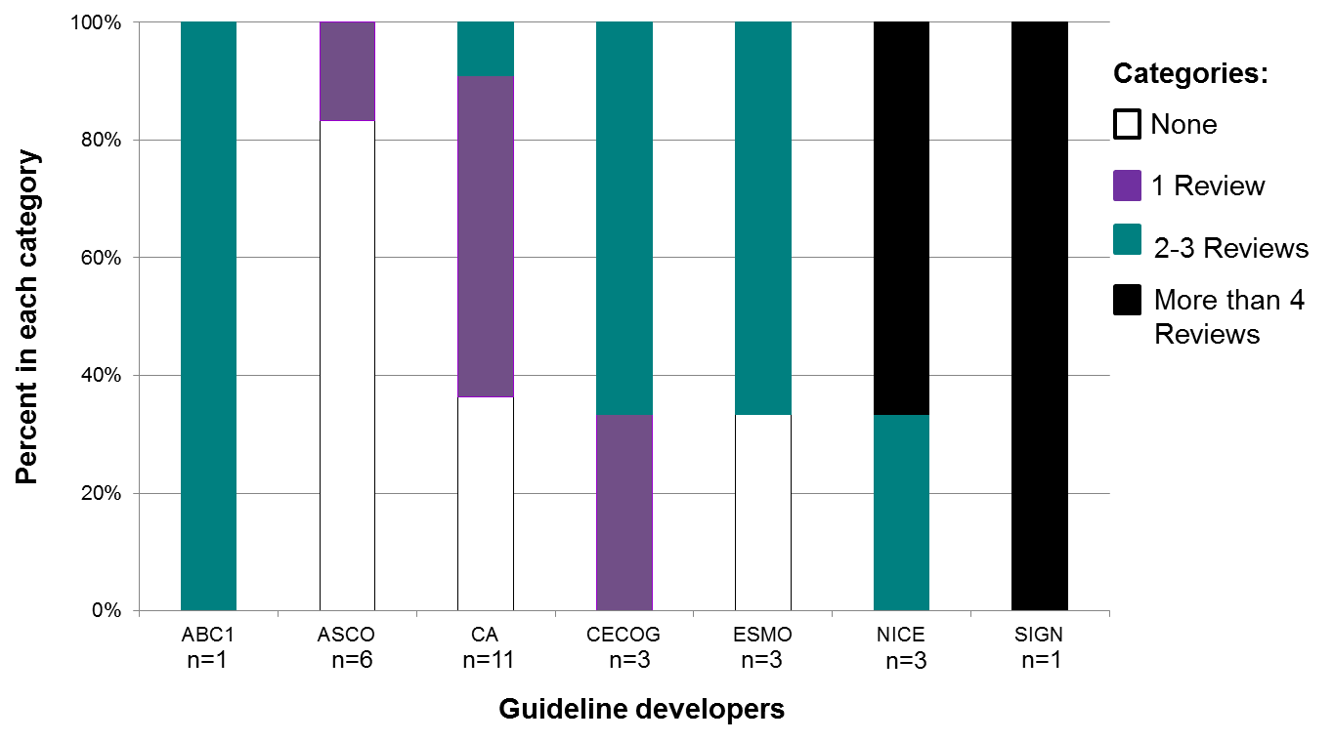
Results: Cochrane Review usage
Notes:
When considering how many Cochrane reviews were used in each guideline, we categorised these into 4 groups:
-guidelines that either:
-did not include a Cochrane review,
-contained one Review,
-contained 2 to 3 Reviews or, had more than 4 reviews.
NICE and SIGN heavily used Cochrane reviews, as shown by the black columns, while there was some variation in use by other guideline developers. Out of the 28 guidelines, 4 were on a specific topic that were not yet covered by a Cochrane review.

Slide 10
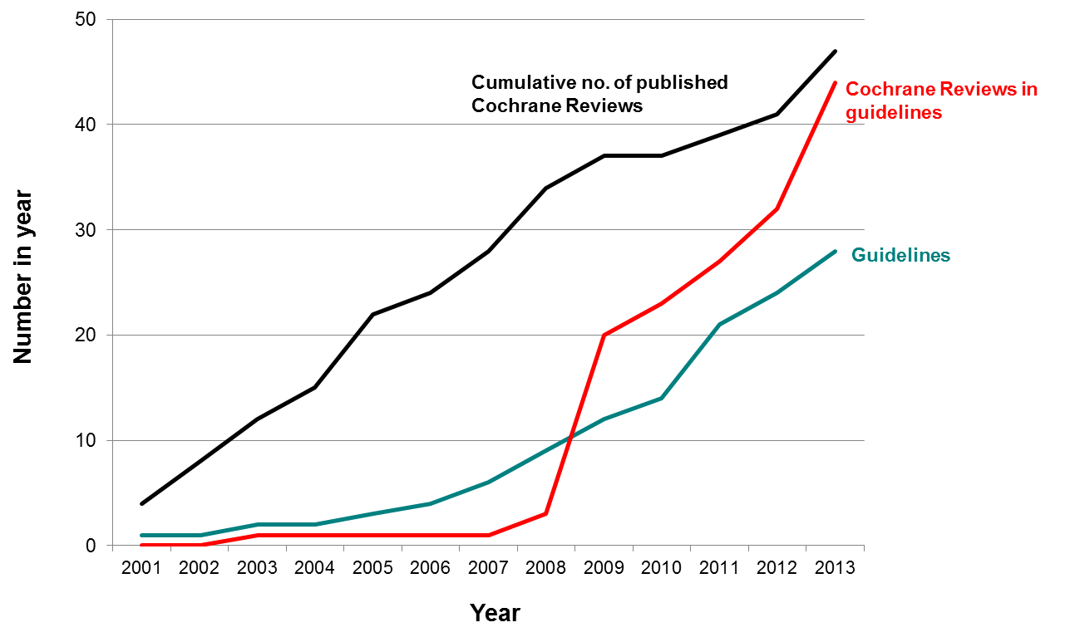
Results: Cochrane Review usage over time
Cumulative no. of guidelines + Cochrane Reviews in guidelines
Notes:
Over time, when considering the cumulative sum of:
-reviews published by us in black
-reviews used in guidelines in red and
-guidelines in breast cancer in green
In red - these may be the same review used repeatedly
The graph illustrates an improvement in Cochrane Review usage, notably from 2009.

Slide 11
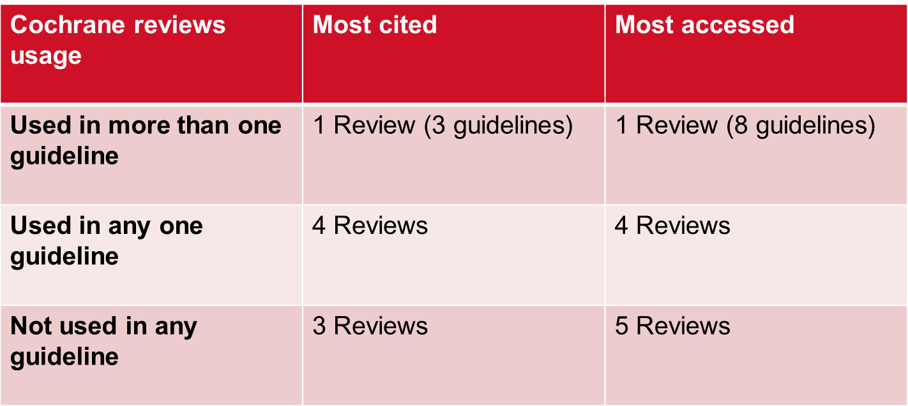
Results: most cited/accessed in guidelines
Notes:
Comparing our most cited or accessed reviews to those used in clinical guidelines, looking at the first two rows, 5 of the 8 most cited reviews AND 5 of the top 10 most accessed reviews were used once or more than once
Looking at the last row, 8 reviews from both lists were not used at all. For these, 2 of the 3 reviews in the most cited list and 4 of the 5 reviews in the most accessed list could have been eligible for inclusion in the guideline.

Slide 12
Results: summary
An increase in Cochrane review uptake in guidelines over time
Variation in Cochrane review citations by guideline developers
An overlap with Reviews used in guidelines and ‘most cited/accessed’ Reviews
10 of 18 ‘most cited/accessed’ Reviews were used once or more than once
Slight disconnect
8 of 18 ‘most cited/accessed’ Reviews were not used
i.e. peripheral topics
Notes:
In sum:
First, this project showed that there has been a steady increase in Cochrane review usage in breast cancer guidelines. There is some variation in use amongst guideline developers, but it should be noted that a low number of Cochrane reviews used in one guideline may correspond to a guideline on a specific topic and hence the reasons for a low number of Cochrane reviews.
Second, an overlap existed between Reviews used in guidelines and the most cited/accessed reviews with 10 of the 18 most cited/read reviews being used once or more than once.
Third, there was a slight disconnect between Cochrane Reviews used in guidelines and by our readers; for reviews that were not used in guidelines, the reviews usually related to peripheral topics such as exercise during adjuvant therapy.

Slide 13
Limits, discussion, future implications
A preliminary assessment; small sample (n=28)
Room to improve communications with guideline developers about upcoming guideline topics
Identified some gaps in our Topics list that will need to be addressed
‘Most cited/read’ reviews tended to be on peripheral topics (e.g. exercise)
Results provide a useful baseline for monitoring the use of our Cochrane reviews
Notes:
To recap:
this was a preliminary assessment. Our sample is small; and we are aware of about 100 breast cancer guidelines. A more thorough examination would be required
there is room to improve our communications with guideline developers. Regular contact and forewarning about upcoming guideline topics would be a good starting point
we identified some gaps in our topics list (e.g. axillary staging) and such reviews are in development
Reviews that were not used in guidelines tended to be on peripheral topics, such as whether or not to exercise during adjuvant therapy. This suggests that our end users search for information differently depending on the topic. For mainstream topics, guideline evidence summaries incorporating Cochrane reviews might be sought but for niche/peripheral topics, information seems to be sought directly from The Cochrane Library.
Finally, these results provide a useful baseline for monitoring the use of Cochrane reviews and and suggest that our Cochrane review topics continue to be of relevance to our end users.

Slide 14
Acknowledgements
A/Prof Nicholas Wilcken (Joint Co-ordinating Editor)
Dr Annabel Goodwin (Joint Co-ordinating Editor)
Prof Dianne O’Connell (Statistical Editor)
Cochrane Breast Cancer Group funders:
National Health and Medical Research Council (NHMRC)
National Breast Cancer Foundation (Australia)
Supported by:
NHMRC Clinical Trials Centre, University of Sydney

Slide 15
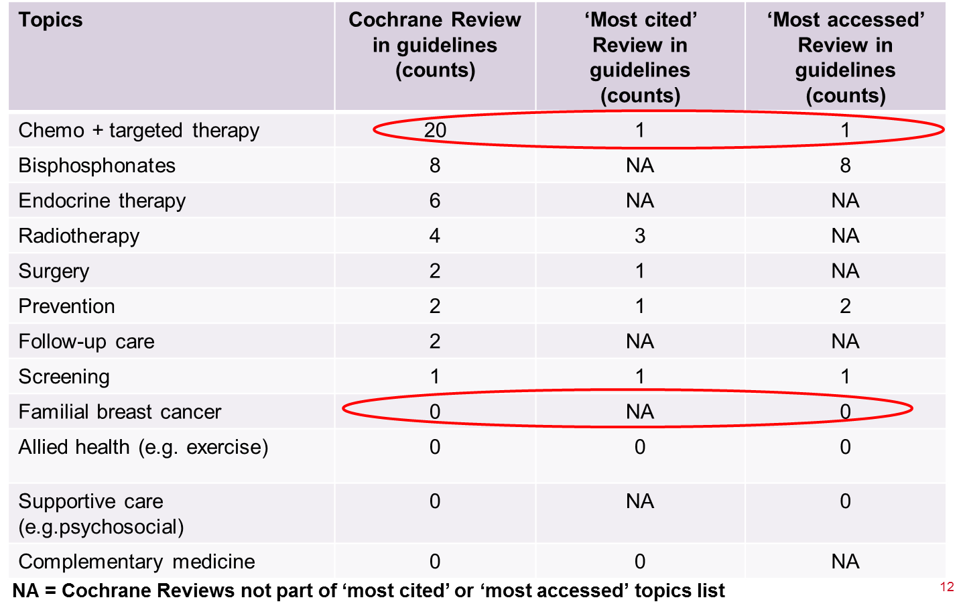
Backup slides
Notes:
In greater detail, this Table highlights the total number of reviews used in each of our topic areas.
Chemo and targeted-therapies frequently used in breast cancer guidelines do not contribute to our most cited/accessed reviews (apart from one review).
Topics of interest to our readers (most cited/read) on bisphosphonates, radiotherapy, surgery, prevention and screening seem to be used in guidelines
In contrast, our most cited/read reviews in familial breast cancer, allied health, supportive care and complementary medicine were never used in guidelines.

